Slide 1


A Fragmented Target Recognition System Based on
Zero-Shot Learning
Chenqing Ji, Yujie Lu, Yongjuan Shi, Guang Wu*
Department of Electric and Electrical Engineering, Southern University of Science and Technology
Shenzhen, China
Presenter: Chenqing Ji
Email: 11911303@mail.sustech.edu.cn

Slide 2
Outline
Motivation
Proposed Fragmented Ingredient Recognition System
DAP (Direct Attribute Prediction) Model
System Implementation
Performance Analysis
Conclusion
2

Slide 3
Outline
Motivation
Proposed Fragmented Ingredient Recognition System
DAP (Direct Attribute Prediction) Model
System Implementation
Performance Analysis
Conclusion
3

Slide 4
Motivation
Why we need Zero-Shot Learning？
In some extreme application scenarios, targets are inevitably fragmented due to the impact of explosion and other factors.
Generally, it is difficult to collect images of these fragmented targets, increasing the difficulty of target recognition and making recognition methods based on traditional deep learning (e.g. CNN) ineffective.
The category labels of the training set and the test set in the Zero-Shot learning model are exclusive, which can make a knowledge transfer between the training set and the testing set.
4

Slide 5

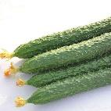
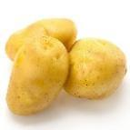


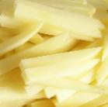
Motivation
Why we need Zero-Shot Learning？
Fig. 1. Intact state and fragmented state of ingredients
(above: Intact state; below: fragmented state)
5

Slide 6
Outline
Motivation
Proposed Fragmented Ingredient Recognition System
DAP (Direct Attribute Prediction) Model
System Implementation
Performance Analysis
Conclusion
6

Slide 7
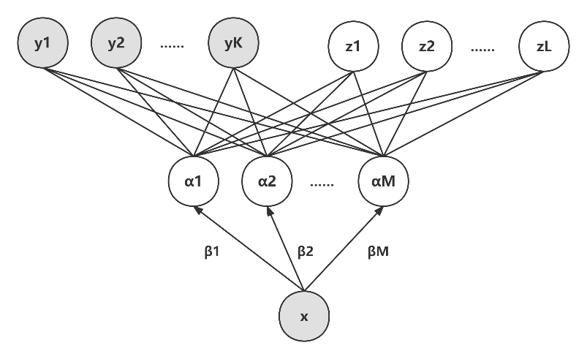
DAP (Direct Attribute Prediction) Model
It proposed by Lampert et al in 2009, which is the first model of Zero-Shot learning applied in the field of computer vision.
It establishes a system of detecting objects from the advanced attribute list, which acts as the middle layer in the classification cascade and realizes the object category detection of Zero Shots.
It introduces a layer of custom attribute which greatly enhances the transfer learning ability of convolutional neural network.
Fig 2. The Structure of DAP model
7

Slide 8
Outline
Motivation
Proposed Fragmented Ingredient Recognition System
DAP (Direct Attribute Prediction) Model
System Implementation
Performance Analysis
Conclusion
8

Slide 9
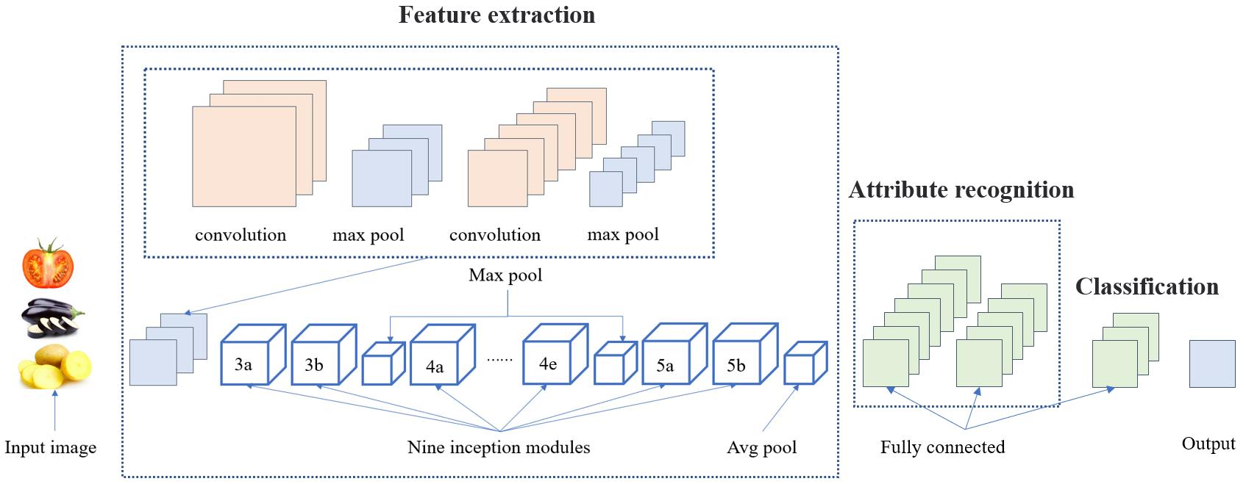
System Implementation
Fig 3. The building of ingredient recognition system
9

Slide 10
Outline
Motivation
Proposed Fragmented Ingredient Recognition System
DAP (Direct Attribute Prediction) Model
System Implementation
Performance Analysis
Conclusion
10

Slide 11
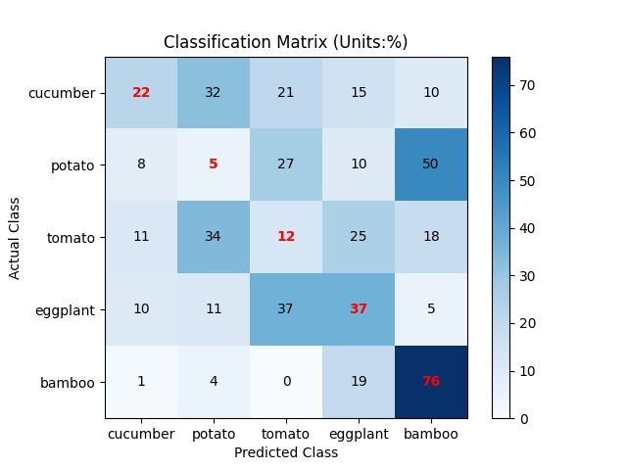
Performance Analysis
Using DAP Model for Zero-Shot Recognition
For bamboo, the recognition accuracy is the highest, reaching 76%. While the recognition accuracy of the other 4 categories of ingredients is lower than 50%.
For potato and tomato, the highest recognition rate was only 5% and 12%.
For cucumber, the system recognizes it in these five categories more evenly than the other four.
For eggplant, the system incorrectly recognizes it as a tomato and correctly identified it are both 37%.
Fig 5. Zero-Shot recognition accuracy
11

Slide 12
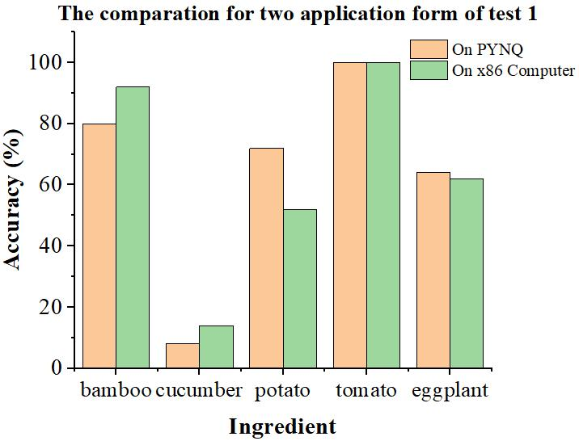
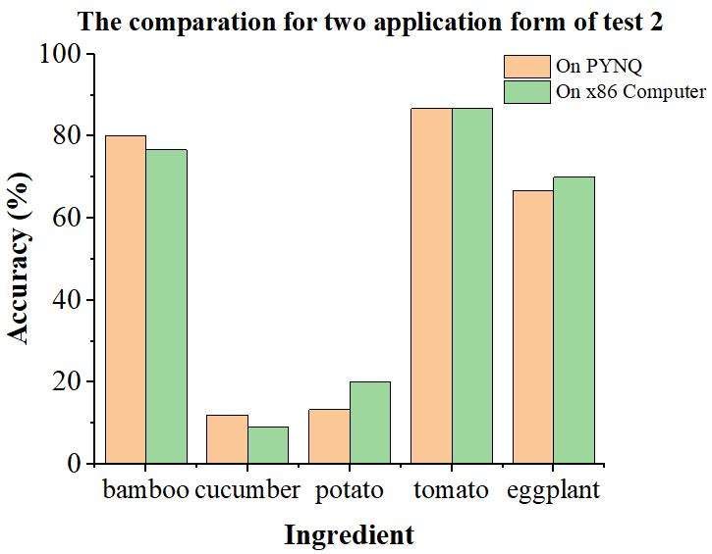
Performance Analysis
Deploy the system on embedded system PYNQ
The system can recognize tomato and bamboo with high accuracy, robustness and universality.
The recognize accuracy of the system for eggplant is general. And the robustness and universality are basically consistent.
For potato, although the robustness of the system is good when recognizing the same image, the universality of the system when recognizing multiple images is poor.
For cucumber, both the robustness and universality of the system are the worst.
Fig 6. The result of the two tests applied to two different platform
12

Slide 13
Outline
Motivation
Proposed Fragmented Ingredient Recognition System
DAP (Direct Attribute Prediction) Model
System Implementation
Performance Analysis
Conclusion
13

Slide 14
Conclusion
What did we do in this Paper？
Innovatively proposes a fragmented target recognition system based on DAP model.
Define a number of high-level binary attributes and after testing when the number of high-level binary attributes is 5, the system can reach the highest recognition accuracy.
Apply the above system to field of fragmented ingredient recognition and obtain the highest recognition accuracy of 76%.
Deploy the whole system on embedded system PYNQ and realize the real-time recognition of the target fragmented ingredients with low power consumption.
14

Slide 15
Reference
[1] Li, Z., Li, F., Zhu, L., & Yue, J. (2020). Vegetable Recognition and Classification Based on Improved VGG Deep Learning Network Model. Int. J. Comput. Intell. Syst., 13, 559-564.
[2] Wei Wang, Vincent W. Zheng, Han Yu, and Chunyan Miao. 2019. A Survey of Zero-Shot Learning: Settings, Methods, and Applications. ACM Trans. Intell. Syst. Technol. 10, 2, Article 13 (March 2019), 37 pages.
[3] L. Pan, S. Pouyanfar, H. Chen, J. Qin and S. -C. Chen, "DeepFood: Automatic Multi-Class Classification of Food Ingredients Using Deep Learning," 2017 IEEE 3rd International Conference on Collaboration and Internet Computing (CIC), 2017, pp. 181-189.
[4] Pan, L., Qin, J., Chen, H., Xiang, X., Li, C., & Chen, R. (2019). Image augmentation-based food recognition with convolutional neural networks. Computers, Materials, & Continua, 59(1), 297-313.
[5] C. H. Lampert, H. Nickisch and S. Harmeling, "Learning to detect unseen object classes by between-class attribute transfer," 2009 IEEE Conference on Computer Vision and Pattern Recognition(CVPR), 2009, pp. 951-958.
[6] Larochelle, H. , Erhan, D. , & Bengio, A. Y. . (2008). Zero-data Learning of New Tasks.
[7] C. Szegedy et al., "Going deeper with convolutions," 2015 IEEE Conference on Computer Vision and Pattern Recognition (CVPR), 2015,pp. 1-9.
[8] Howard, A. G. , Zhu, M. , Chen, B. , Kalenichenko, D. , Wang, W. , & Weyand, T. , et al. (2017). Mobilenets: efficient convolutional neural networks for mobile vision applications.
15

Slide 16

Thank You for Your Attention!

